Slide 1
Year 11 ATAR Biology
Week 20 - Features of Eukaryote cells

Slide 2

Year 11 Biology Work Schedule
It is important to remain on schedule during this Semester.
Moodle
Have you visited Moodle this week? Yes / No
Tasks
Are you on schedule? Yes / No
When is your next task due?

Slide 3
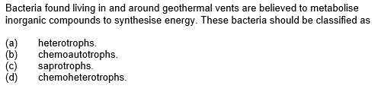
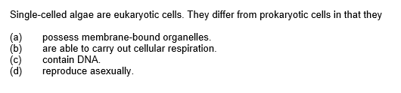
Review
Notes:
B
A

Slide 4
Learning Intentions
Eukaryotic cells carry out specific cellular functions in specialised structures and organelles, including:
        cell membrane
        cell wall
        chloroplasts
        endoplasmic reticulum (rough and smooth)
        golgi apparatus
The cell membrane model has been continually reconceptualised and revised and the currently accepted model, is the fluid mosaic model.
        lysosomes
        mitochondria
        nucleus
        ribosomes
        vacuoles
Success criteria
Students will be able to:
Describe the structure and function of cell organelles.
Label eukaryotic cell organelles.

Slide 5
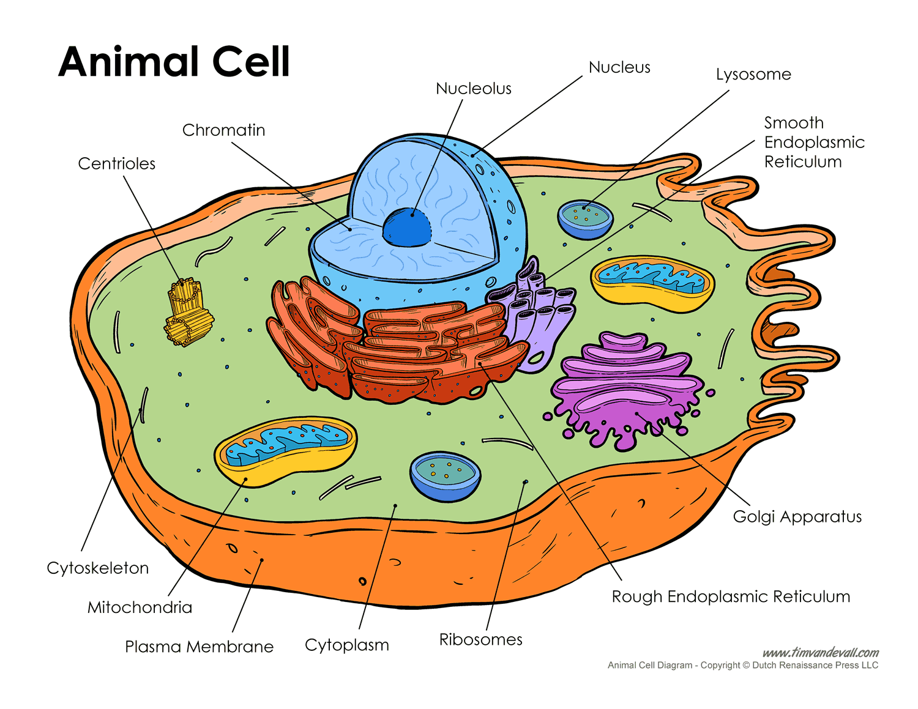
Yr 8 Science: What do you remember?

Slide 6
Yr 8 Science: What do you remember?

Slide 7
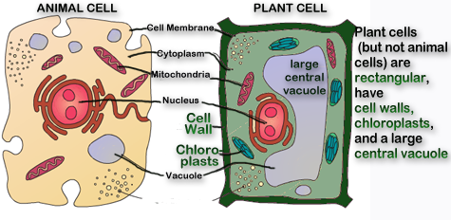
Animal & Plant Cells
Animal and plant cells have many organelles in common, as well as several features specific to each.
Organelle is a part within a cell that has a specific function.

Slide 8
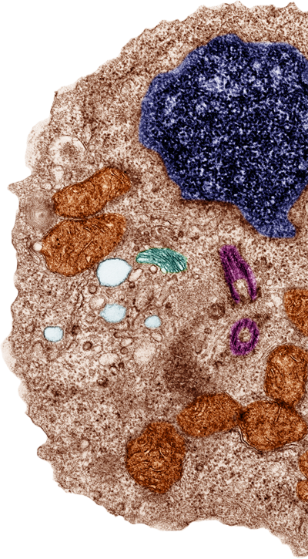
Features Shared by Plant and Animal Cells
Some cellular organelles are commonly found in both plant and animal cells, while others are found exclusively in just one or the other cell type.
Organelles and structures common to
both plant and animal cells include:
  nucleus
  plasma membrane
  ribosomes
  mitochondria
  golgi apparatus
  endoplasmic reticulum (rough and smooth)
  cytoskeleton
  vacuoles and vesicles, although these differ
  in size and function in plants and animal cells.

Slide 9
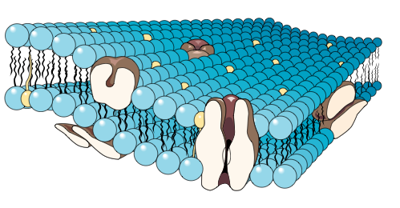
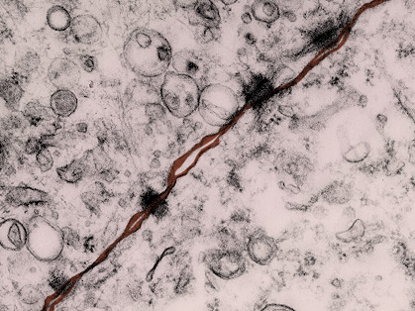
Plasma Membrane
Located:
Surrounds the cell forming a
boundary between the cell contents and the extracellular environment.
Structure:
Semi-fluid phospholipid bilayer in which proteins are embedded. Some of the proteins fully span the membrane.
Function:
  Forms the boundary between the cell and the extracellular environment.
  Regulates movement of substances in and out of the cell.
Size: 3–10 nm thick.
Phospholipid bilayer
Protein
The plasma membranes of two adjacent cells joined with desmosomes
Notes:
Integral and peripheral proteins
Desmosomes =cell to cell adhesions.
1 micron = 1000 nanometers

Slide 10
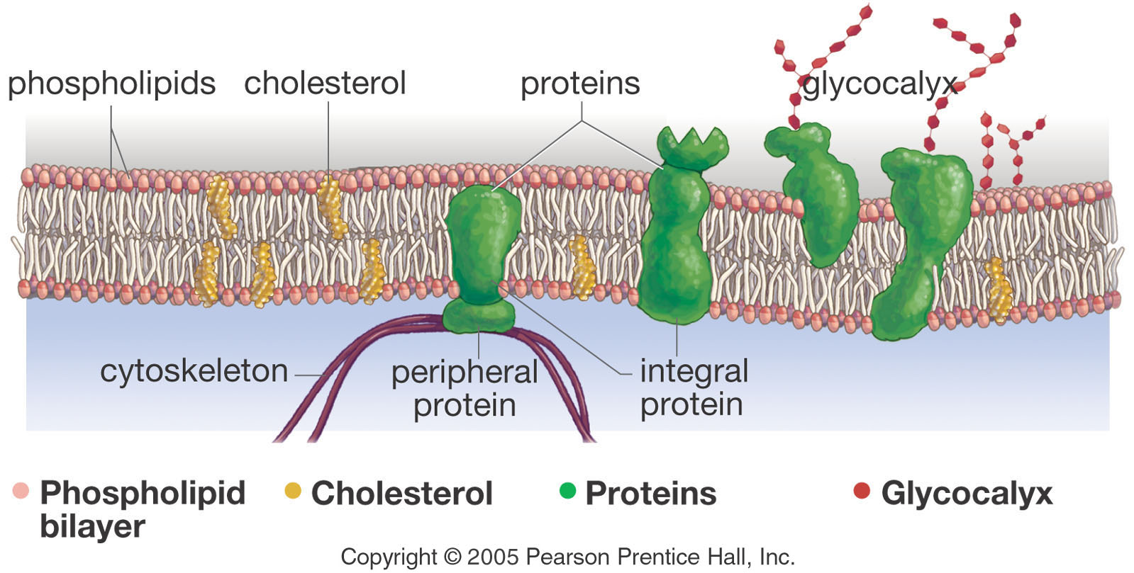
Plasma Membrane
Parts of the plasma membrane include -
Notes:
Cholesterol plays important roles in maintaining the structural integrity and regulating the fluidity of cell membranes.

Slide 11
Plasma Membrane
Cells need an inside & an outside to separate the cell from its environment. Plasma membrane is the boundary.
IN
food
- sugars
- proteins
- fats
- salts
- O₂
- H₂O
OUT
waste
- ammonia
- salts
- CO₂
- H₂O
products
- proteins
cell needs materials in & products or waste out

Slide 12
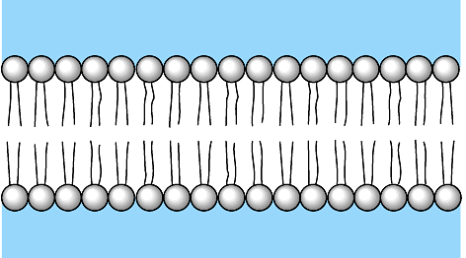
Plasma Membrane
Membrane is made of phospholipids, with a phosphate head (hydrophilic – water loving) and a lipid tail (hydrophobic – water repelling). Membrane is a double layer hence the name phospholipid bilayer.
“attracted to water”
phosphate
inside cell
lipid
outside cell
“repelled by water”
Notes:
Hydrophilic – able to absorb water or dissolve in water
Hydrophobic – water avoiding/repelling
In a bilayer the tails turn toward each other away from the watery environment and cytoplasm.

Slide 13
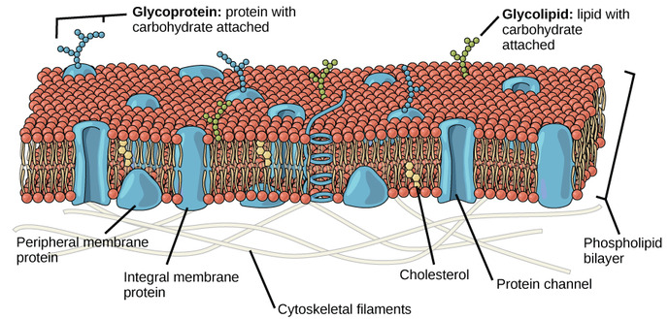
Plasma Membrane
Plasma membrane is often called the fluid mosaic model
FLUID - because individual phospholipids and proteins can move side-to-side within the layer, like it’s a liquid.
MOSAIC - because of the pattern produced by the scattered protein molecules when the membrane is viewed from above.

Slide 14
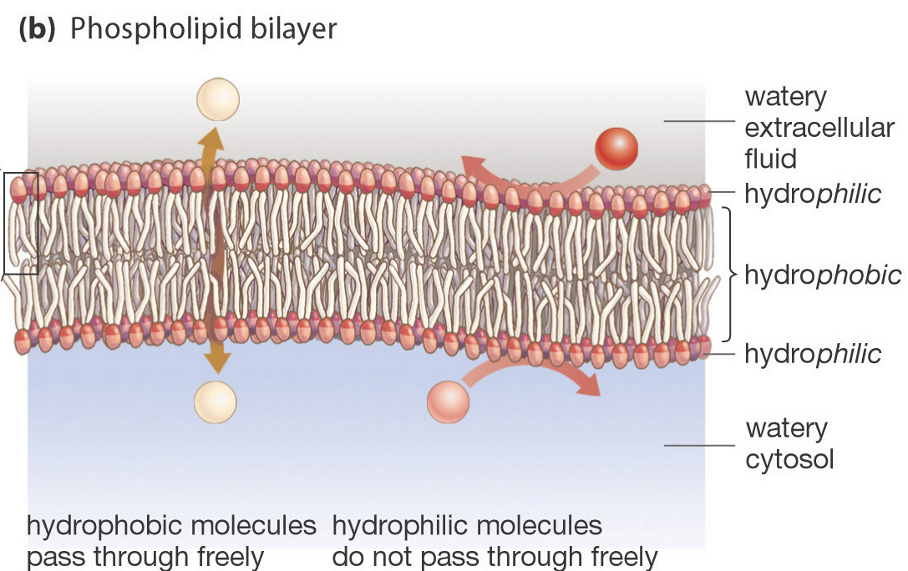
Plasma Membrane
Phosphate (polar) heads are hydrophilic “water loving” Lipid (nonpolar) tails are hydrophobic “water fearing”.
This makes the membrane selective in what can cross it, hence the name selectively permeable.
Lipid-soluble substances, such as oxygen, carbon dioxide and steroids can pass through.
Water-soluble substances, such as glucose, amino acids, and ions need the help of various proteins for transport across the membrane.
Notes:
Because cell is mostly lipid, only allows lipid soluble substances to pass through easily. Water soluble substances need the help of proteins to pass through.

Slide 15
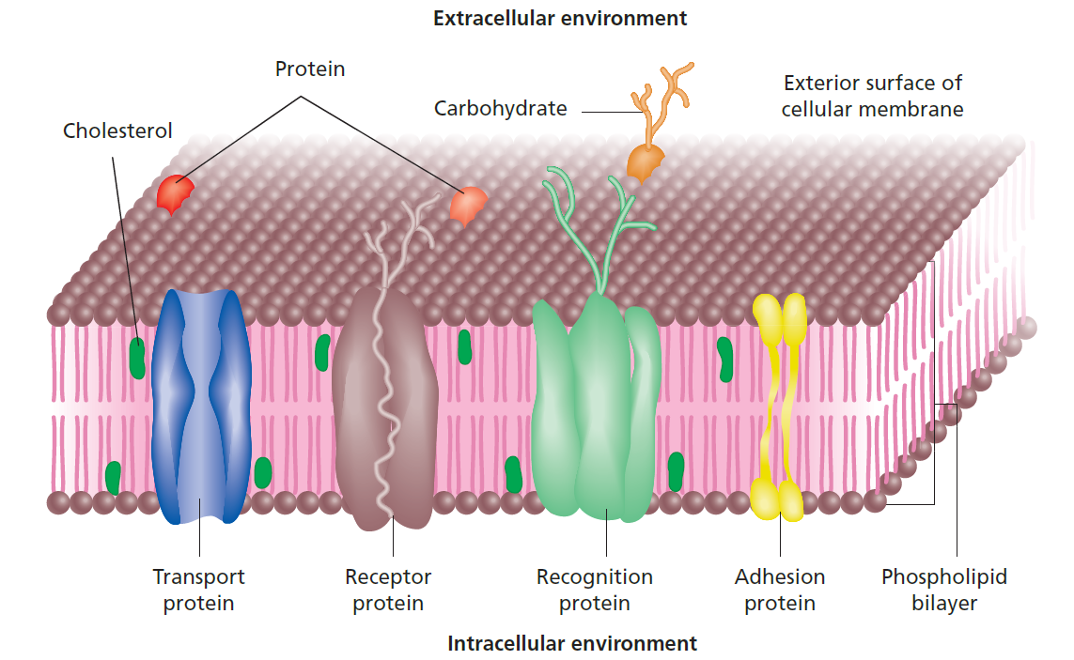
Plasma Membrane
Protein molecules are embedded in the phospholipid bilayer. The different proteins include:
  Transport proteins (channel and carrier proteins) – passageways to move substances
  Receptor proteins – bind to hormones to cause changes in cell activity
  Recognition proteins (glycoproteins) – act as markers so the body recognises them as “own” cells.
  Enzymes – help perform cellular reactions.
  Adhesion proteins – help maintain structure.
Animal cells also have cholesterol embedded in the layer to improve flexibility.
https://www.wisc-online.com/learn/natural-science/life-science/ap1101/construction-of-the-cell-membrane
Notes:
Plant cells have phytosterol not cholesterol. They’re interspersed among the phospholipid molecules and affect interactions – can help the flexibility and structure

Slide 16
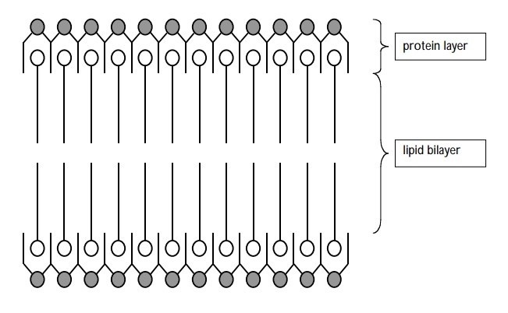
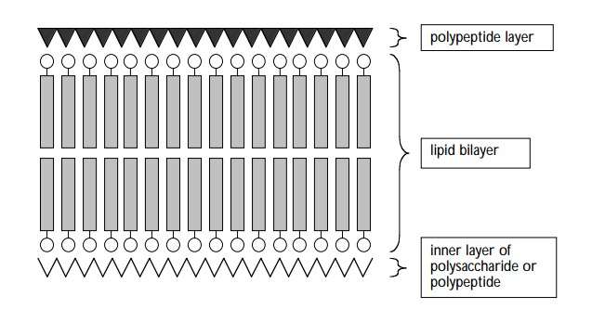
Plasma Membrane
DANIELLI AND DAVSON MODEL - 1954
The theory of the fluid mosaic model of the cell membrane took several years to develop.
Read pg 186 of Nelson “Scientific Literacy – Development of the Cell Membrane Model” and complete the questions.
For more information check out http://www.whatislife.com/education/fact/history.htm
ROBERTSON MODEL - 1959

Slide 17
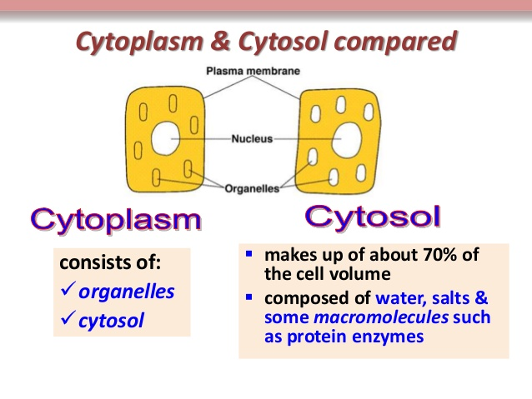
Cytoplasm
All cells also have cytoplasm, which is a clear, jelly-like fluid that fills the inside of the cell.
It provides a suspension solution for the organelles.
It’s the site for many of the chemical reactions that occur in the cell.
Cytoplasm is responsible for giving a cell its shape. It helps to fill out the cell and keeps organelles in their place. Without cytoplasm, the cell would be deflated and materials would not be able to pass easily from one organelle to another.
Cytosol is the part of the cytoplasm that does not contain organelles.

Slide 18

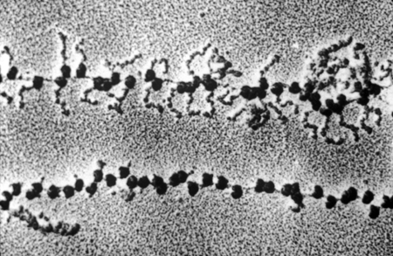
Ribosomes
Small subunit
Located:
Free in the cytoplasm or bound to rough endoplasmic reticulum.
Structure:
Made up of ribosomal RNA and protein and composed of two subunits, a larger and a smaller one.
Function:
Makes polypeptides
(proteins).
Size: 20 nm
Large subunit
Polypeptide chain
Ribosomes
Polypeptides being produced by translation on a polyribosome system
Notes:
Need to be viewed with an electron microscope. Proteins are required for growth, repair and general cell functioning.

Slide 19
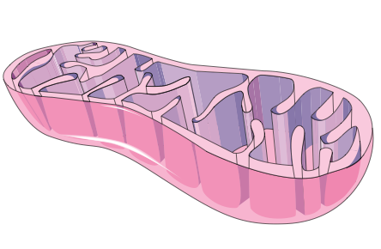
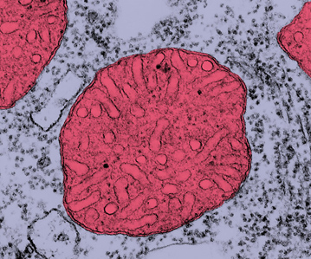
Mitochondria
Folded inner membrane forms cristae
Location: Cytoplasm
Structure:
Rod shaped or cylindrical
organelles occurring in large numbers, especially in metabolically very active cells. Bounded by a double membrane; the inner layer is extensively folded to form partitions called cristae. Mitochondria contain some DNA.
Function:
The site of cellular respiration (the production of ATP).
Size: Variable but 0.5–1.5 µm wide and 3.0–10 µm long.
Smooth outer membrane
Matrix
A single mitochondrion in cross section
Notes:
Enzymes for cellular respiration contain within cristae and increase SA for chemical reactions to occur.

Slide 20
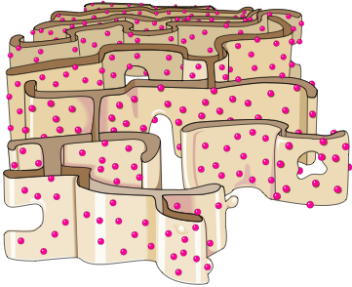
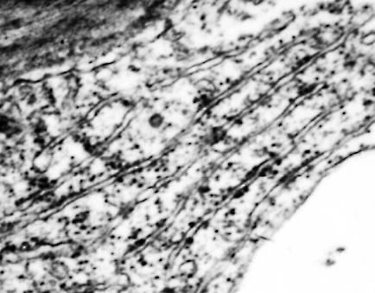
Rough Endoplasmic
Reticulum
Membranous tubules
Ribosome
Location:
Continuous with the nuclear membrane and extending to the cytoplasm.
Structure:
A complex system of membranous tubules studded with ribosomes. Connected to the smooth ER but structurally and functionally distinct from it.
Function:
  Synthesis, folding, and
  modification of proteins.
  Transport of proteins through the cell.
  Membrane production.
Size: Variable according to cell size.
Transport vesicle budding off
Notes:
Some of the proteins are delivered into the lumen or space inside the ER whilst others are processed within the ER membrane itself. Some proteins may undergo glycosylation. It is also in the lumen that an amazing process of quality control checking is carried out. Proteins are subjected to a quality control check and any that are found to be incorrectly formed or incorrectly folded are rejected.

Slide 21
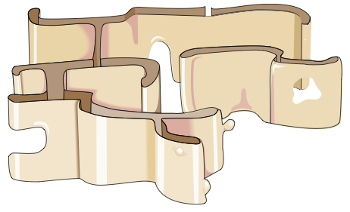
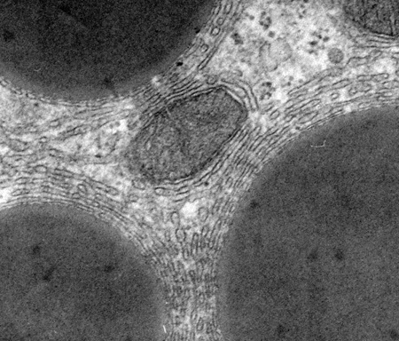
Smooth Endoplasmic
Reticulum
Membranous tubules lacking ribosomes
Located:
In the cytoplasm
Structure:
A system of membranous tubules similar in appearance to the rough ER but lacking ribosomes.
Function:
  Synthesis of lipids, including oils, phospholipids, and steroids.
  Carbohydrate metabolism.
  Transport of these materials through the cell.
  Detoxification of drugs and poisons.
Size: Variable according to cell size.
Transport vesicle budding off
Notes:
There are two types of endoplasmic reticulum: rough endoplasmic reticulum (rough ER) and smooth endoplasmic reticulum (smooth ER). Both types are present in plant and animal cells. The two types of ER often appear as if separate, but they are sub-compartments of the same organelle. Cells specialising in the production of proteins will tend to have a larger amount of rough ER whilst cells producing lipids (fats) and steroid hormones will have a greater amount of smooth ER.
Part of the ER is contiguous with the nuclear envelope.

Slide 22
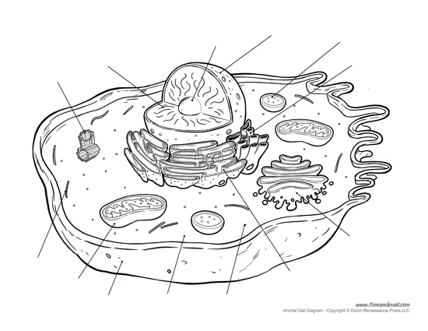
Success Criteria: label cell organelles
Chromatin

Slide 23
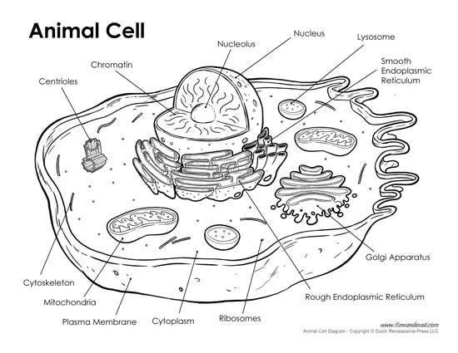

Slide 24

Moodle & Textbook Work
Read Nelson pages 245-250 and 257-259.
Complete question sets 8.2 and 8.5.
Complete Chapter review questions 1-12.

Slide 25
Student Feedback
What I learnt today…..
What I need to revise….

Slide 27
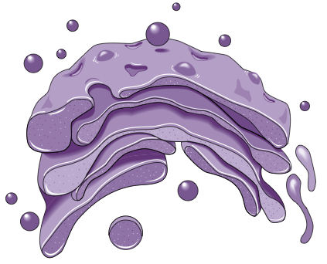
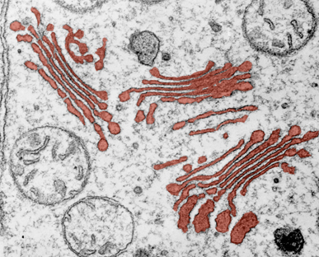
Golgi Apparatus
Transfer vesicle from the ER
Cisternae
Location: Cytoplasm
Structure:
Stack of flattened, membranous sacs called cisternae.
Function:
  Modification of proteins and lipids received from the ER, eg. Protein glycosylation.
  Sorting, packaging, and storage of proteins and lipids.
  Transport of these materials in vesicles through the cell.
  Manufacture of some certain macromolecules, eg. hyaluronic acid.
Size: 1-3 µm diameter
Vesicle from the ‘shipping’ side of the Golgi
Notes:
The Golgi apparatus is also closely associated with the ER and recent observations suggest that parts of the two organelles, i.e. the ER and the Golgi complex, are so close that some chemical products probably pass directly between them instead of being packaged into vesicles (droplets enclosed within a membrane) and transported to them through the cytoplasm.

Slide 28
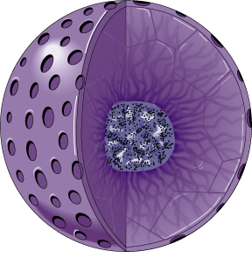
Nucleus
Nuclear pores
Located:
Variable location; not necessarily near the center of the cell.
Structure:
Surrounded by a nuclear envelope and encloses the genetic material (chromatin). Nuclear envelope comprises a double membrane perforated by pores.
Function:
Contains most of the cell’s genetic material, which regulates all the
activities of the cell.
Size: 5 µm diameter.
Nuclear membrane
Nucleolus
Chromatin

Slide 29
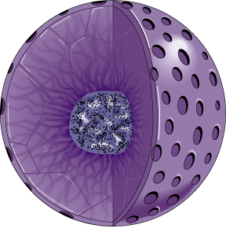
Nucleolus
Located: Within the nucleus.
Depending on the organism, there may be more than one.
Structure:
A prominent structure which appears under EM as a mass of darkly stained granules and fibers adjoining part of the chromatin.
Function:
  Synthesis of ribosomal RNA
  Assembly of ribosomal subunits.
Size: 1-2 µm diameter.
Nucleolus
Notes:
The primary function of the nucleolus is to produce ribosomes (via ribosomal RNA (rRNA) transcription, rRNA processing and ribosome subunit assembly).

Slide 30
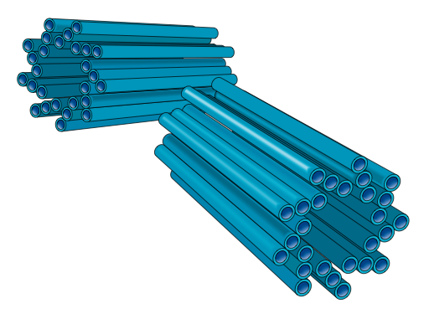
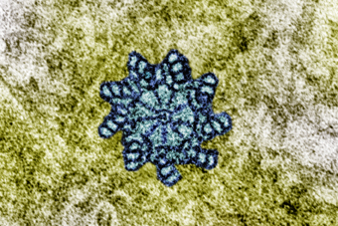
Centrioles
Microtubules
Located:
In the cytoplasm, as part of the cell cytoskeleton. Usually next to or close to the nucleus.
Structure:
Found as a pair, each one composed of nine sets of triplet microtubules arranged in a ring.
Function:
Involved in cell reproduction (formation of the spindle)
Size: 0.25 µm diameter.
Centriole in cross section

Slide 31
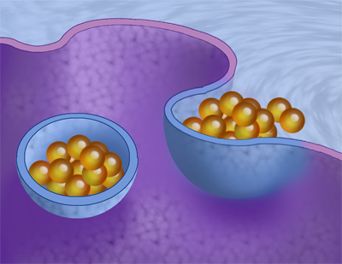
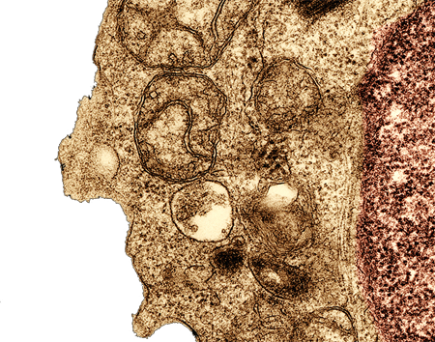
Vacuoles and Vesicles
Endocytosis:
Located:
In the cytoplasm; often numerous.
Structure:
Vacuoles and vesicles are both membrane-bound sacs, but vacuoles are larger.
Function:
  food vacuoles in animal cells are formed by endocytosis of food particles.
  contractile vacuoles of freshwater protists pump excess water from the cell.
  central vacuole of plants provides cell volume and stores inorganic ions and metabolic wastes.
Size: varies according to
cell type and size.
Food vacuole in a human lymphocyte

Slide 32
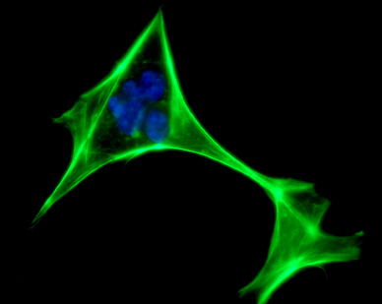
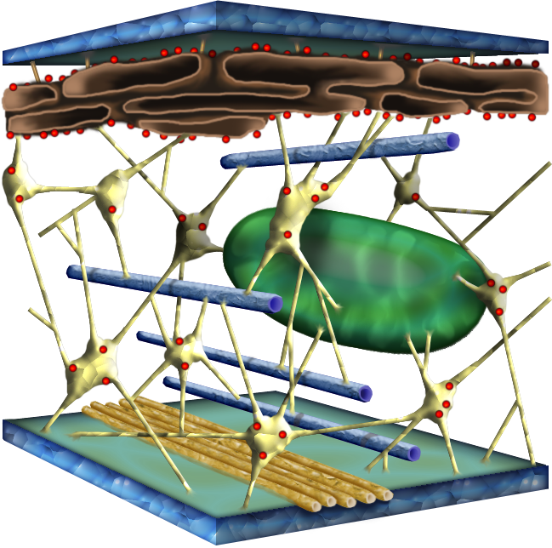
The Cell Cytoskeleton
Located:
A network throughout the cytoplasm.
Structure:
A dynamic system of microtubules, microfilaments, and intermediate filaments.
Function:
  shape and mechanical support for the cell
  regulation of cellular activities, e.g. guiding secretory vesicles.
  especially important in animal cells.
  involved in cell movement (motility).
Size:
  microtubules: 25 nm
  microfilaments (actin filaments): 7 nm
  intermediate filaments: 8-12 nm
An actin stain reveals the cytoskeleton of a fibroblast
iStock

Slide 33
The Cell Cytoskeleton
Plasma membrane
Intermediate filament
An organelle held in place by cytoskeleton
Microtubule
Microfilament

Slide 34
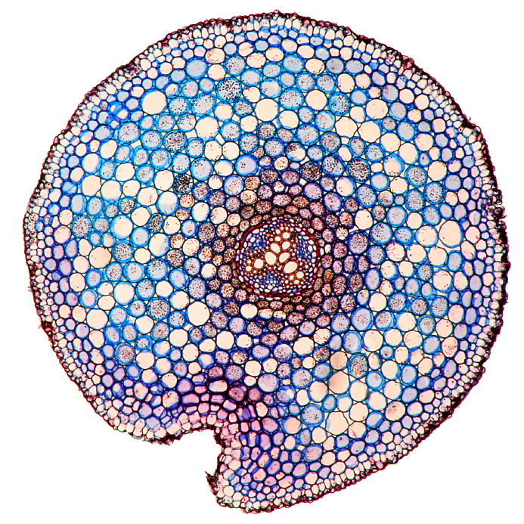
Specialist Plant Cell Features
A small number of cellular organelles are typically found in plant cells but not in animal cells.
Organelles and structures found in plant cells are:
  cellulose cell wall
  plastids
    chloroplasts
    amyloplasts
    chromoplasts
iStock
Cross section through a buttercup stem showing the individual cells

Slide 35
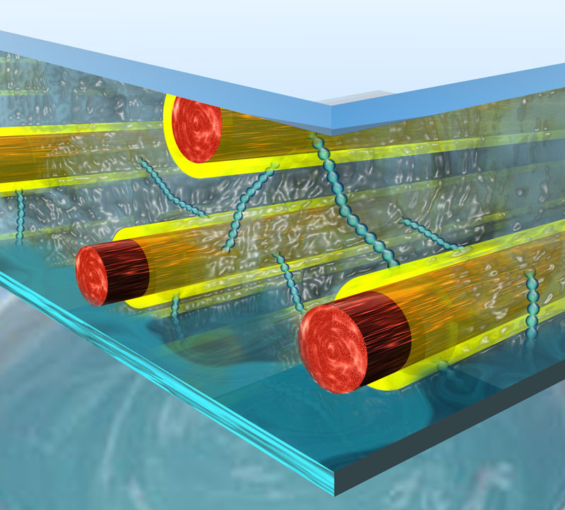
Cellulose Cell Wall
Middle lamella
Location:
Surrounds the plant cell and lies outside the plasma membrane.
Structure:
Cellulose fibers. Between the walls of adjacent cells, is a sticky substance called the middle lamella.
Function:
  protects the cell
  maintains cell shape
  prevents excessive water uptake
Size: 0.1 µm to several µm thick.
Pectins
Hemicelluloses
Cellulose fibers
Diagrammatic representation of plant cell wall structure
Notes:
The cellulose molecules provide tensile strength to the primary cell wall. Each molecule consists of a linear chain of at least 500 glucose residues that are covalently linked to one another to form a ribbonlike structure.

Slide 36
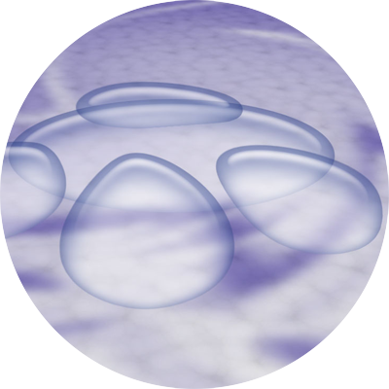
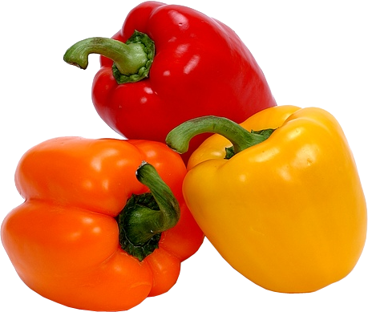
Plastids
Colorless amyloplasts in potato tubers
Located:
In the cytoplasm.
Structure:
Double membrane-bound structures.
The inner membranes typically possess the enzymes that determine what plastids do.
Function:
Different plastids have particular roles:
  Chloroplasts; site of photosynthesis
  Chromoplasts: contain red, orange,
  and/or yellow pigments and give color to plant organs such as flowers and fruits. They serve as attractants and identifiers.
  Amyloplasts: storage of starch and fats.
Size: variable depending on type
Chromoplasts provide the bright color of flowers and fruit

Slide 37
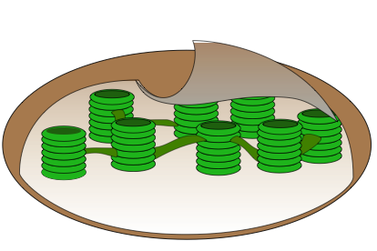
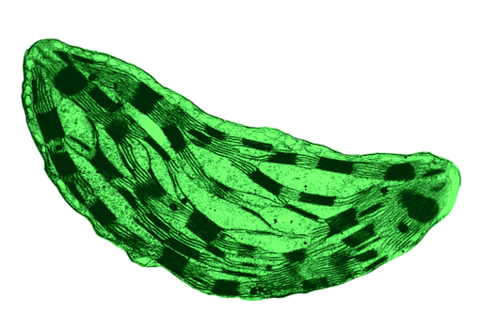
Chloroplasts
Grana
Stroma
Located:
Within the cytoplasm of plant leaf (and sometimes stem) cells.
Structure:
  Specialized plastids containing the green pigment chlorophyll.
  Two outer membranes are separated by a narrow inter-membrane space.
  Inside the chloroplasts are stacks of flattened sacs.
  Chloroplasts contain some DNA
Function:
The site of photosynthesis
Size: 2 X 5 µm

Slide 38
Specialist Animal Cell Features
A small number of cellular organelles are typically found in animal cells but not in plant cells.
Organelles and structures found in animal cells are:
  lysosomes
  cilia
  flagella
TEM of a human lymphocyte

Slide 39
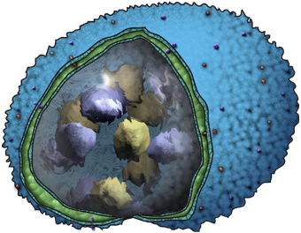
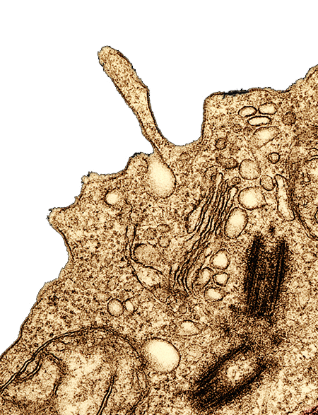
Lysosomes
Membrane proteins
Located:
Free in the cytoplasm.
Structure:
Single-membrane-bound sac of hydrolytic enzymes. Lysosomes bud off the Golgi apparatus.
Function:
  intracellular digestion of macromolecules (fats, protein, polysaccharides, and nucleic acids)
  recycling of cellular components
Size: varies according to cell size.
Hydrolytic enzymes break down compounds by adding water
Lysosomes in a lymphocyte. Note how they are budding from the Golgi

Slide 40
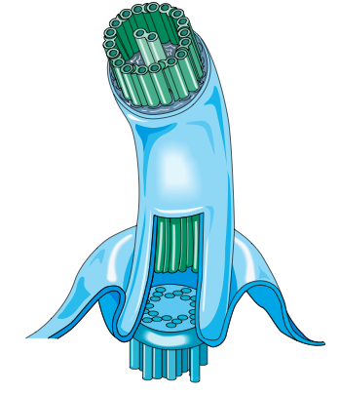
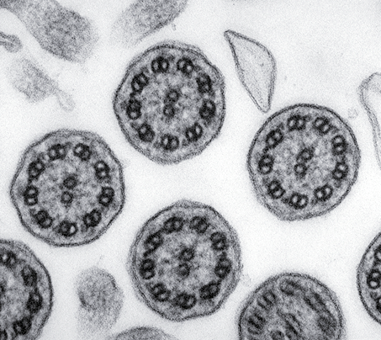
Cilia and Flagella
2 central single microtubules
9 doublets of microtubules
Located:
Anchored to the cell membrane of some animal cells and unicellular eukaryotes.
Structure:
Core of microtubules sheathed in an extension of the plasma membrane. Microtubules are arranged in a 9+2 pattern with nine doublets of microtubules arranged in a ring
around two single microtubules.
Function:
Cell motility or, in cells held in place, they move fluid across the cell surface.
Size:
  Cilia: 0.25 µm X 2-20 µm
  Flagella: 0.25 µm X 10-200 µm
Plasma membrane extension
Basal body
anchors the cilium
TEM of cilia in cross section

Slide 41
Success Criteria: label cell organelles
Chromatin

Slide 43
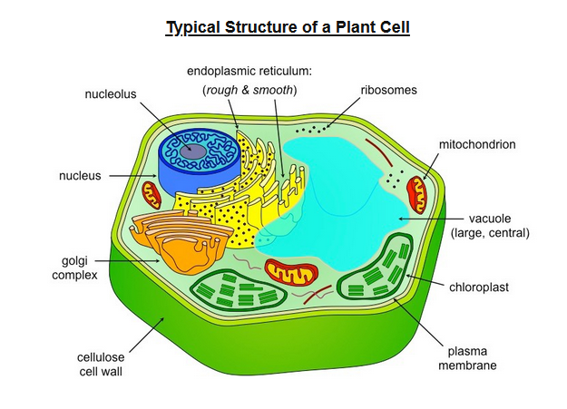

Slide 44
Plant cell structure and function

Slide 45
Plant and Animal Cell Similarities
Both contain:
  Nucleus, Nuclear membrane, Chromosomes- which carry the genes or the DNA.
  Cytoplasm
  Mitochondria
  Plasma membranes
  Ribosomes
  Golgi apparatus
  Endoplasmic reticulum (rough and smooth)
  Cytoskeleton

Slide 46
Plant and Animal Cell Differences
Plant cells have non-living rigid cell walls.
Plant cells contain chloroplasts which contain chlorophyll, a green chemical needed for photosynthesis.
Plant cells contain a large vacuole; animal cells never contain large vacuoles.
Plant cells are regular in shape; animal cells are irregular in shape.
Animals cells often have cilia or flagella and lysosomes; plant cells do not.

Slide 47
Online Activity
Check out the links below for some online interactive activity on plant and animal cell organelles. Each link has a tutorial, game and quiz.
http://www.sheppardsoftware.com/health/anatomy/cell/plant_cell_game.htm
http://www.sheppardsoftware.com/health/anatomy/cell/cell_game.htm

Slide 48
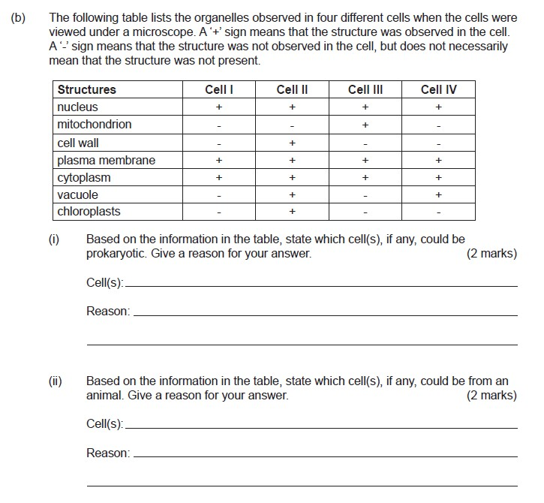
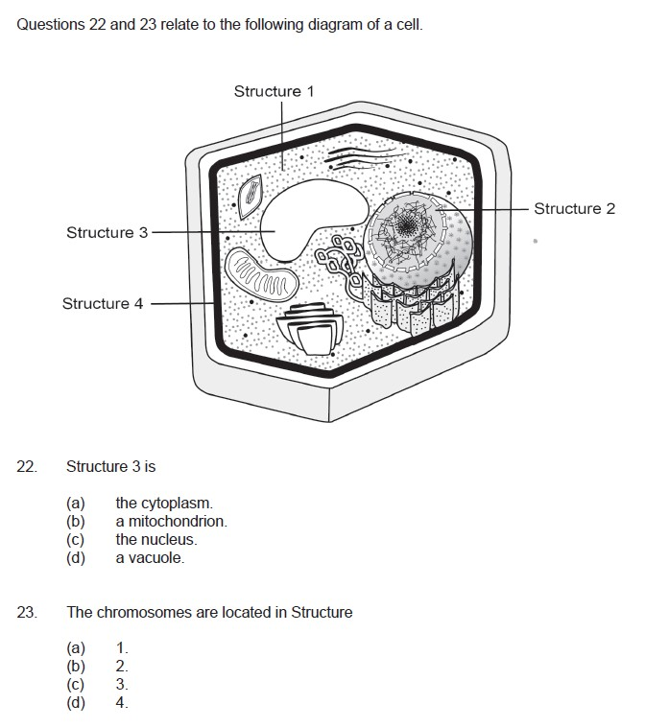
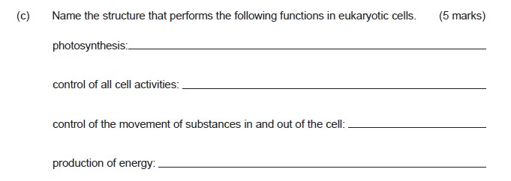
Exam Question Review
Notes:
Stage 2 wace 2013 & 2013

Slide 49
Moodle & Textbook Work
Read Nelson pages 245-250 and 257-259.
Complete question sets 8.2 and 8.5.
Complete Chapter review questions 1-12.

Slide 50
Student Feedback
What I learnt today…..
What I need to revise….

